Slide 1
Privacy Local Authority
Kayla L – Learning Module Designer

Slide 2
Objectives
What is privacy?
Why does privacy matter?
Access and privacy legislation
Information and Privacy Commissioner
Privacy best practices

Slide 3
What is privacy?
Privacy is:
The right to be left alone
Autonomy to decide how your information is collected, used and disclosed

Slide 4
Why does privacy matter?
Ensure confidence between the public and the local authority
Ensures compliance with legislated authority
Protects the safety and well-being of an individual
Ensure the local authority is complying with their duty to protect

Slide 5
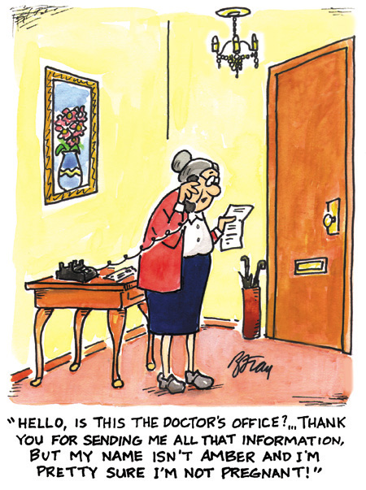
https://professionals.wrha.mb.ca/old/extranet/inspire/2014/140319-Privacy-cartoon.php

Slide 6
The Local Authority Freedom of Information and Protection of Privacy Act (LAFOIP)
Local authorities
Outlines how local authorities collect, use and disclose personal information
Health Information Protection Act (HIPA)
Trustees
Outlines how trustees collect, use and disclose personal health information

Slide 7

Oversight body for local authorities, government institutions and trustees that are subject to The Freedom of Information and Protection of Privacy, LAFOIP and HIPA
Mediates access and privacy disputes between the public and local authorities/trustees
Reviews and provides recommendations on privacy impact assessments
OIPC Photo

Slide 8
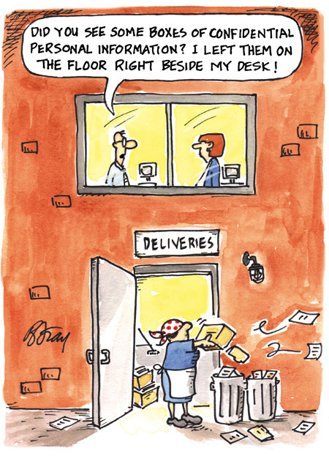

Slide 9
Privacy Best Practices
Lock your computer when you are away from your workstation.
Never leave personal information or personal health information unattended in a public place
Watch your subject line
Refrain from including personal information in the Subject line of your emails
Confirm the recipient
Double check the recipients (whether faxed or emailed) is correct before you send any confidential information.
Lock your computer
Bring it with you

Slide 10
Thank you
Kayla L
KaylaL.VA@outlook.ca

